Slide 1
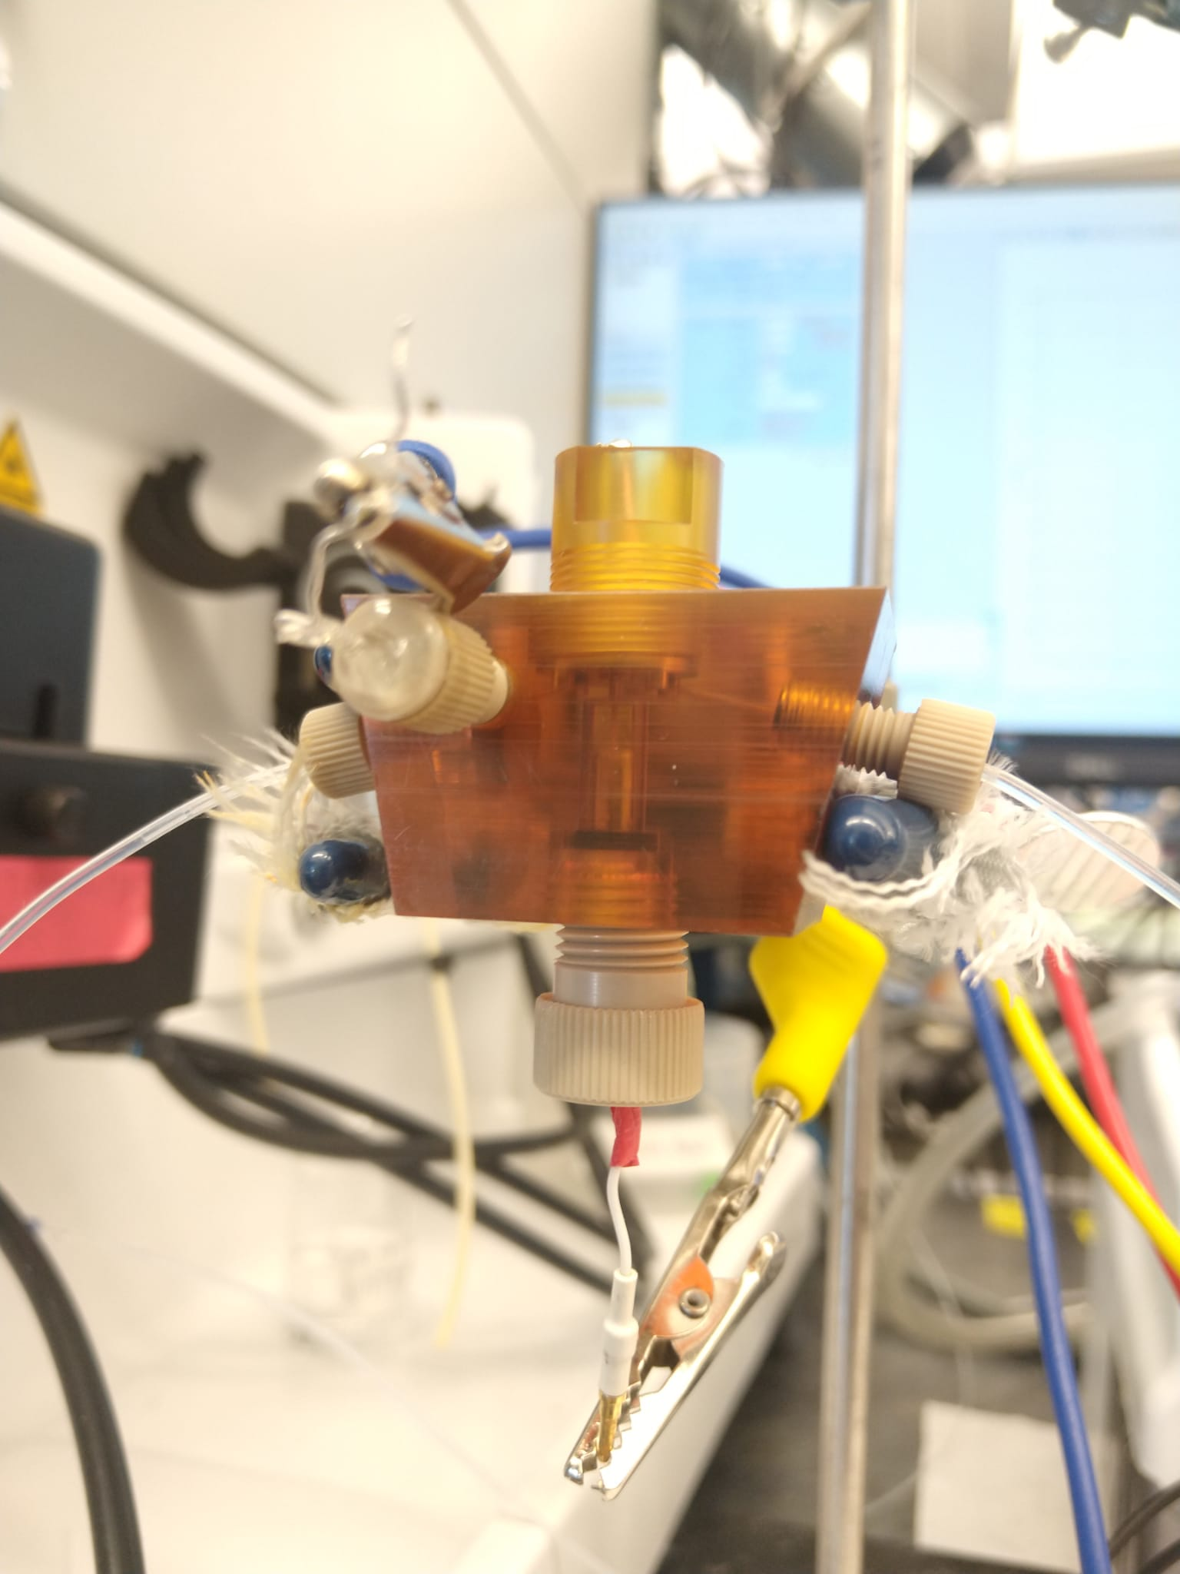
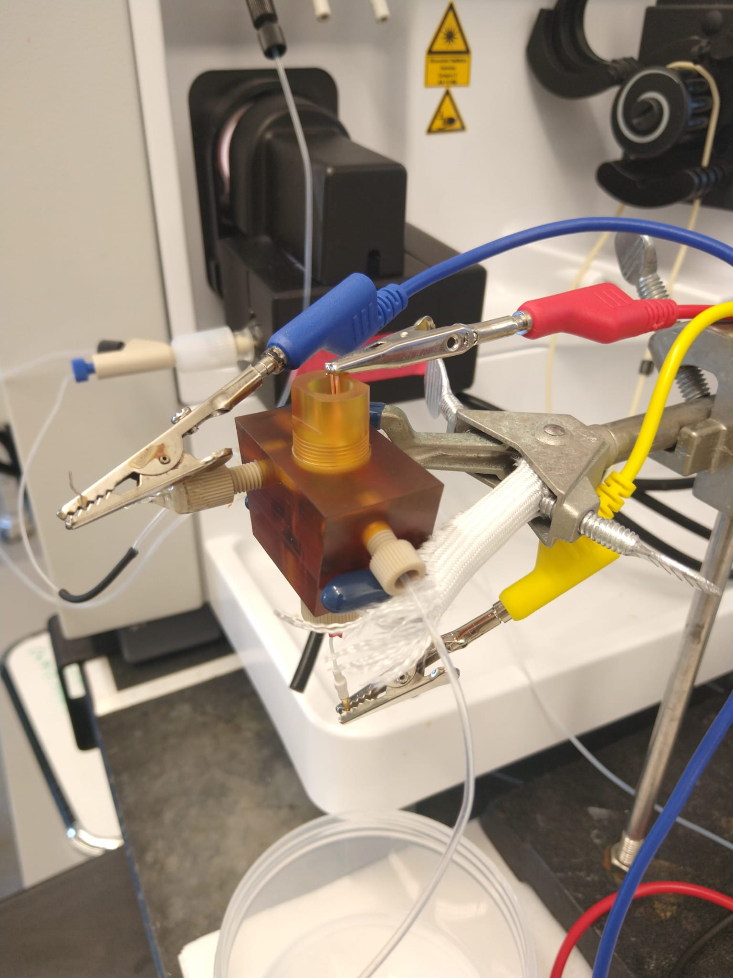
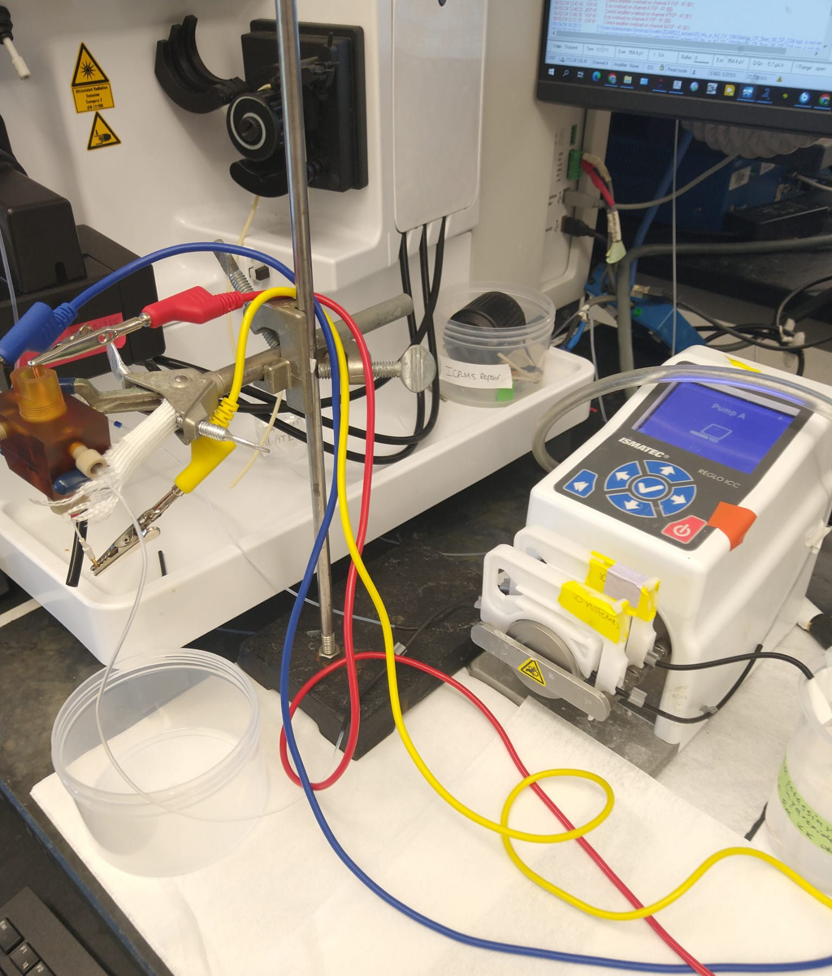
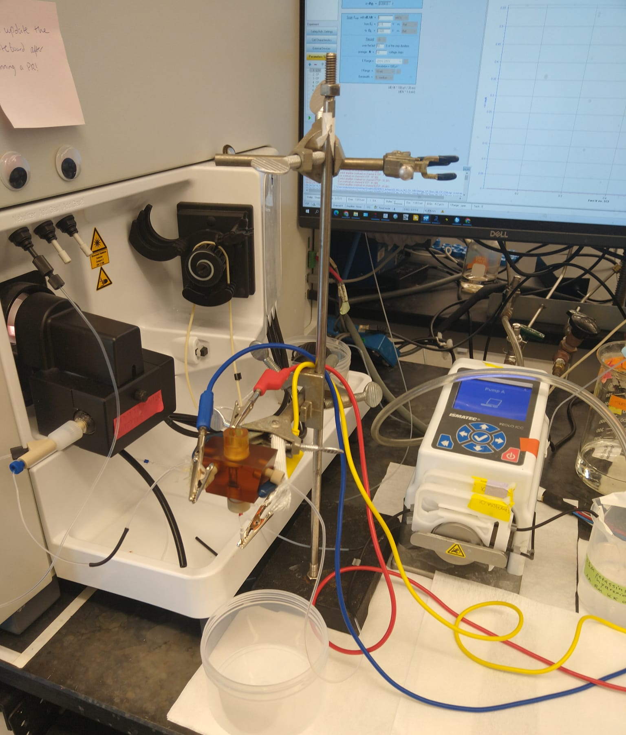
a
b
ICP torch
WE
Flow cell body
Nebulizer
Flow out
Flow in
WE
CE
CE
Flow in
RE
RE
c
d
ICP torch
Peristaltic pump
Peristaltic pump
Flow cell
Gas bubbler
Flow cell
WE
RE
Nebulizer
Electrolyte reservoir
CE

Slide 2
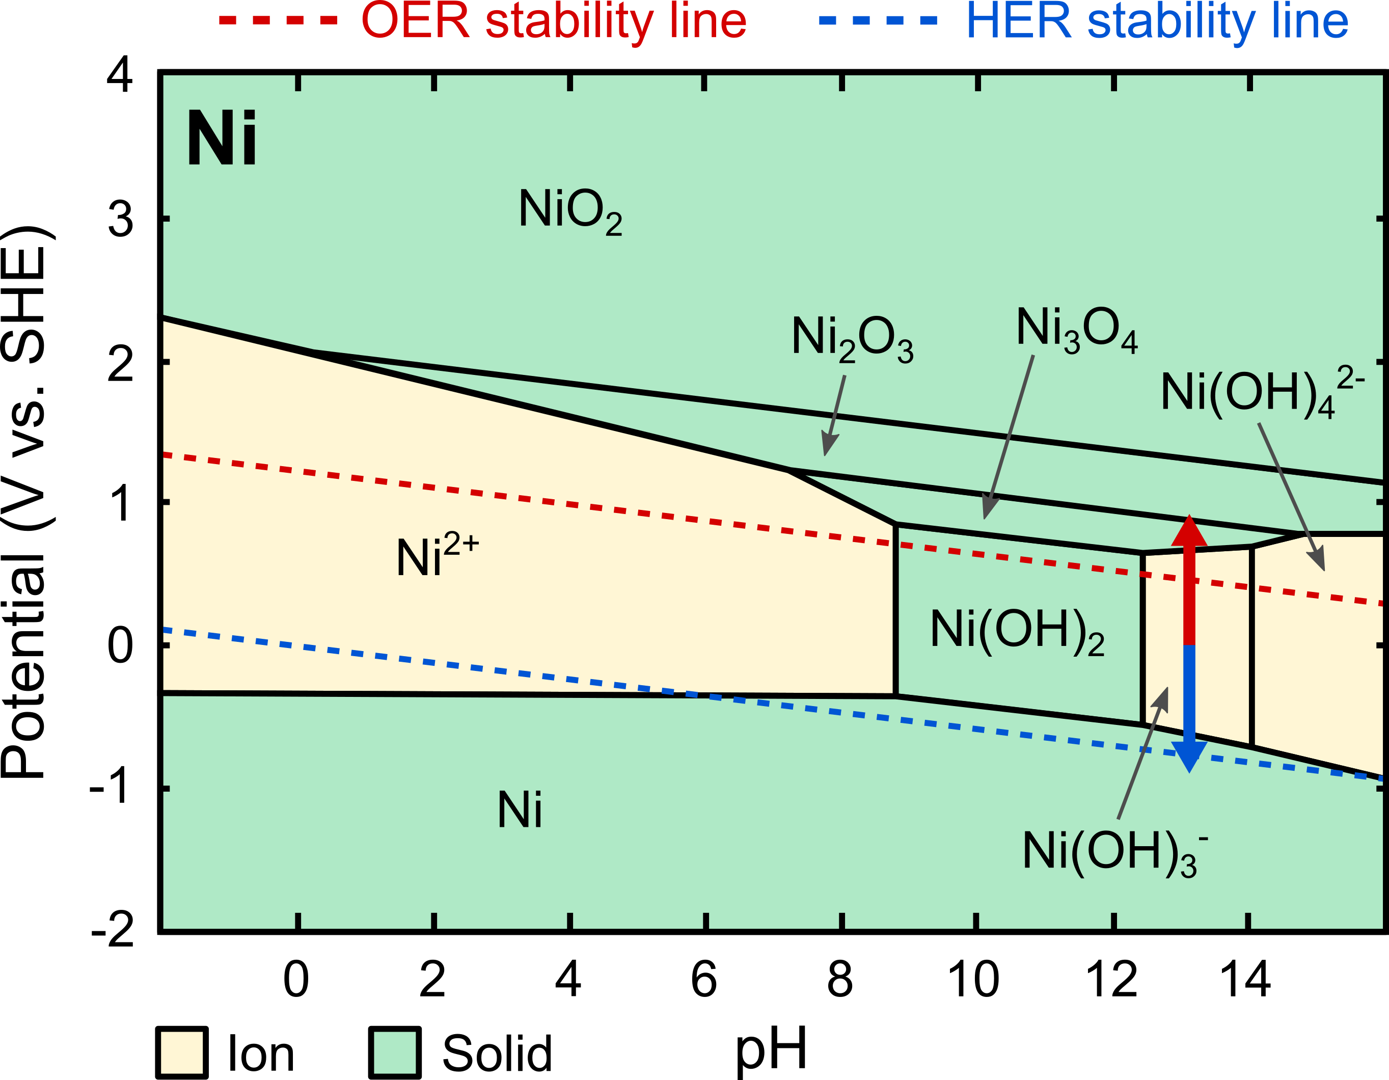
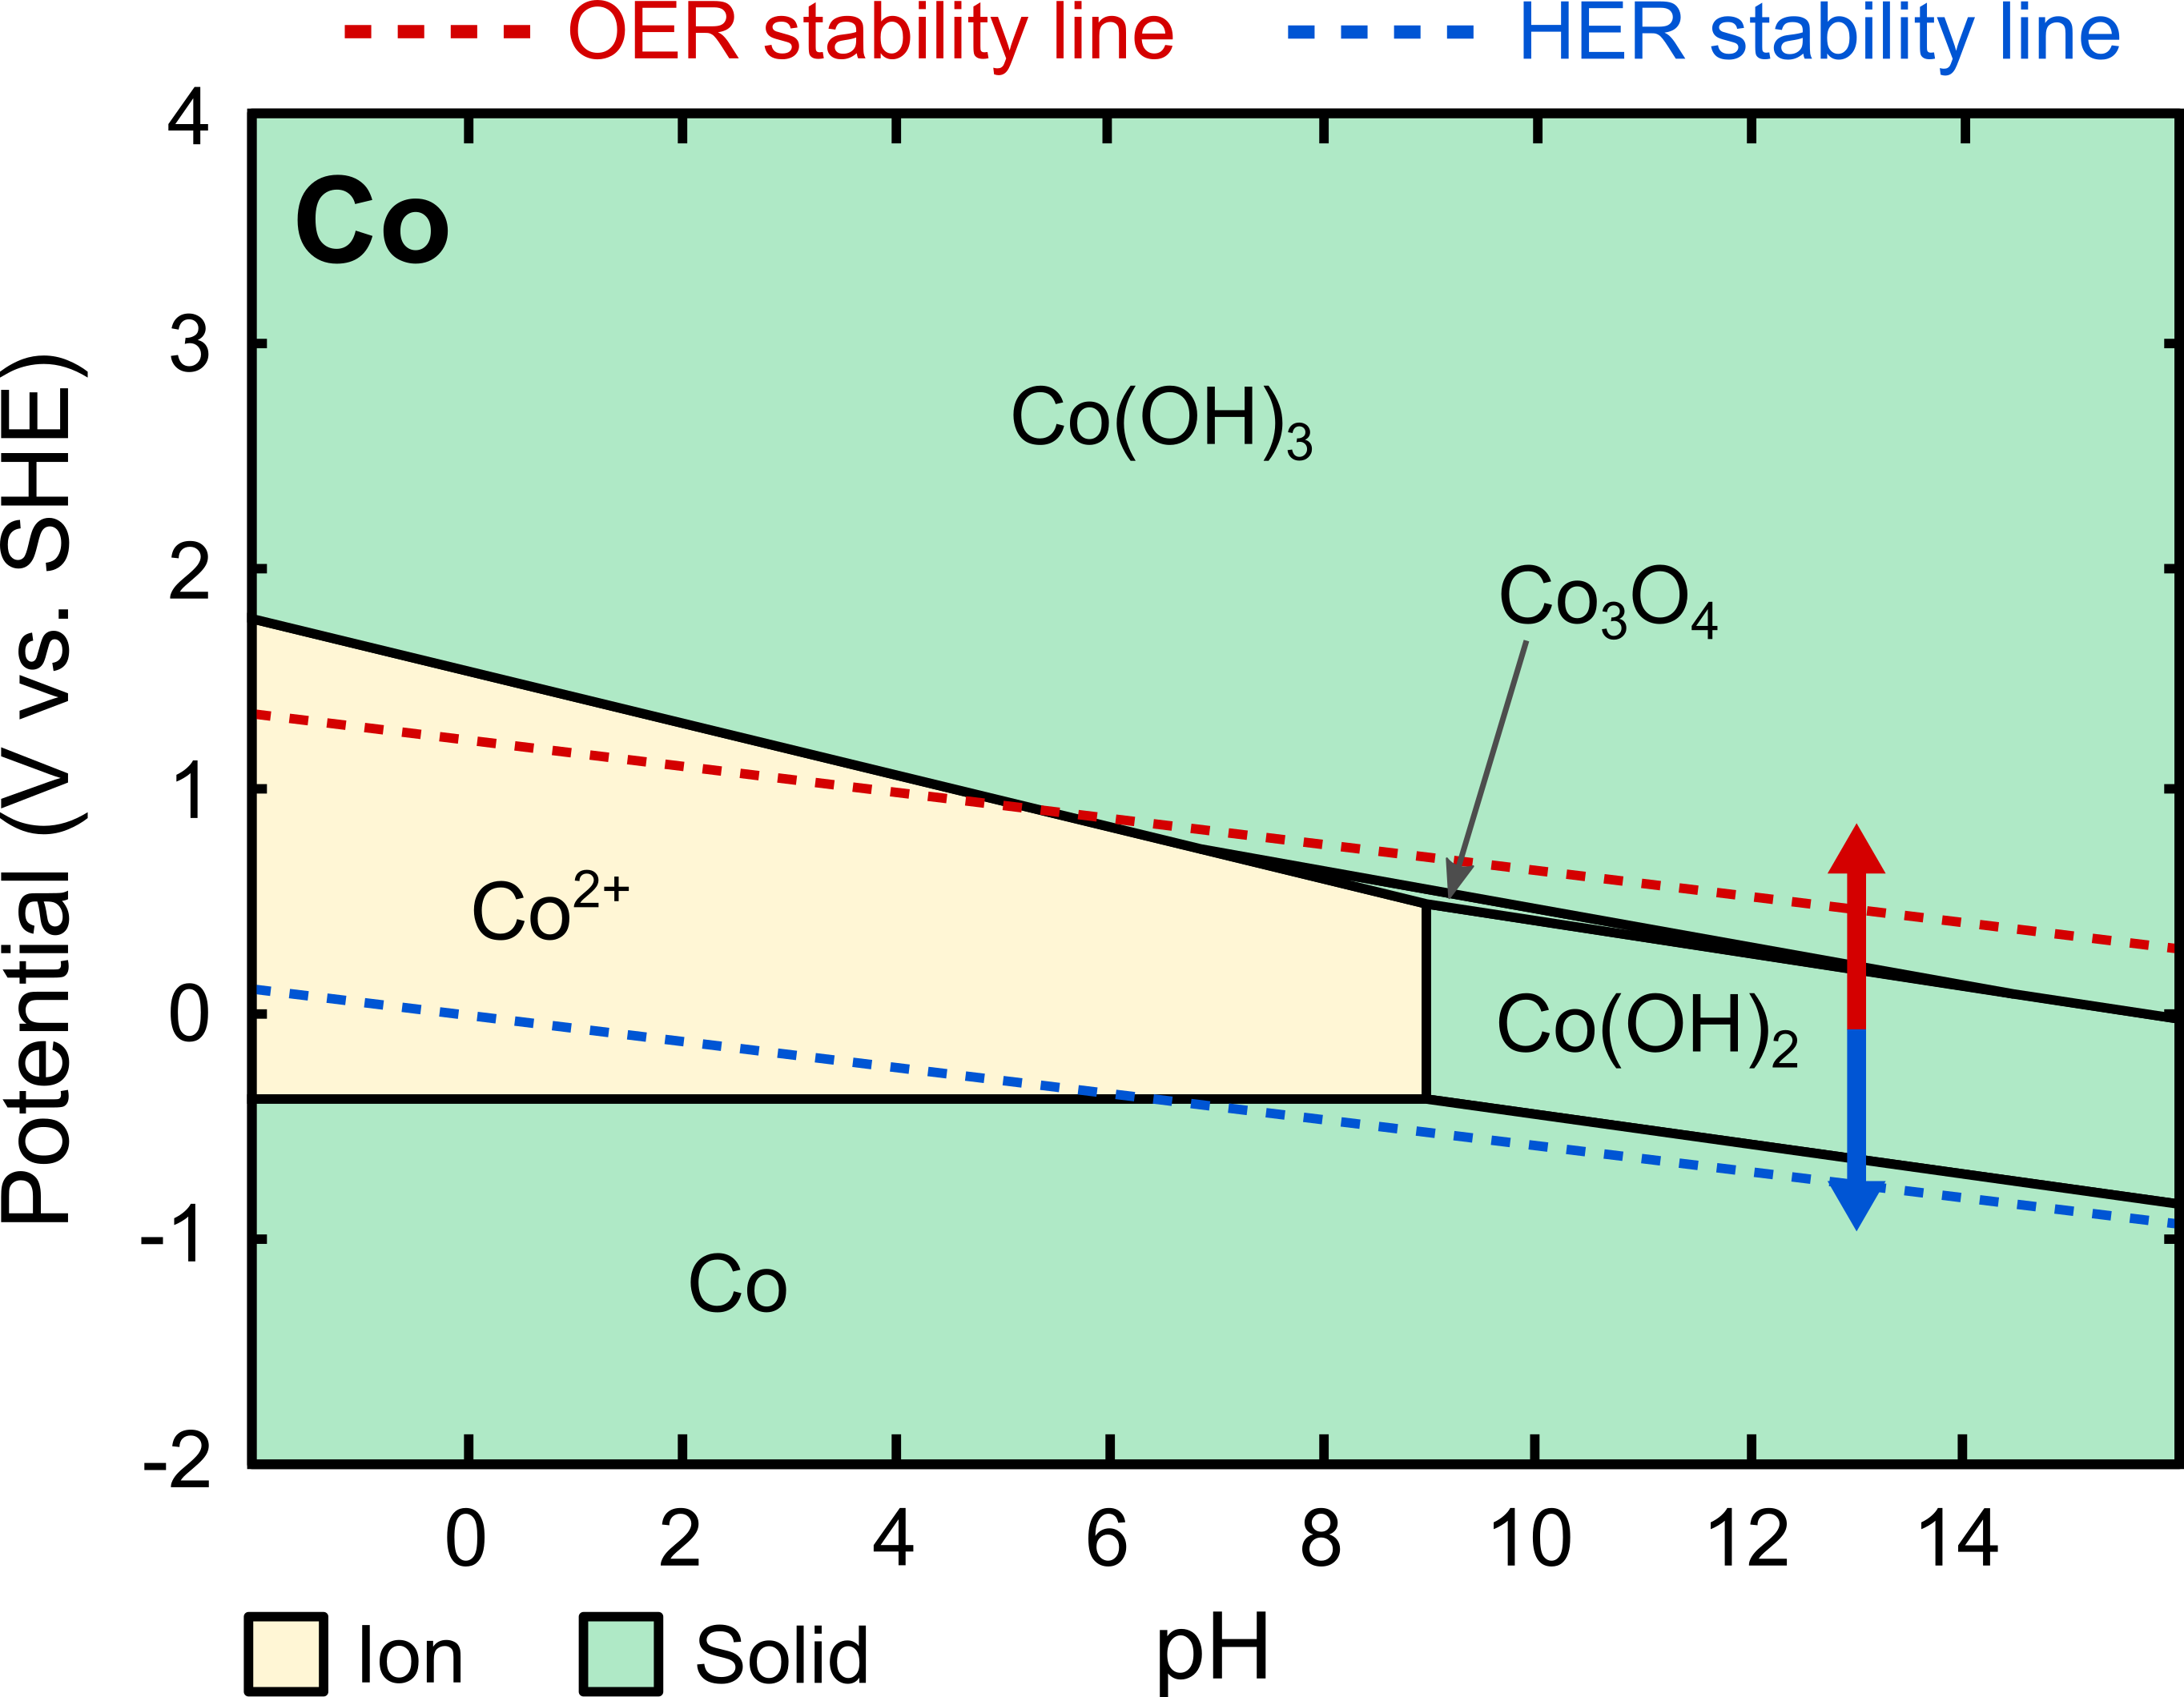
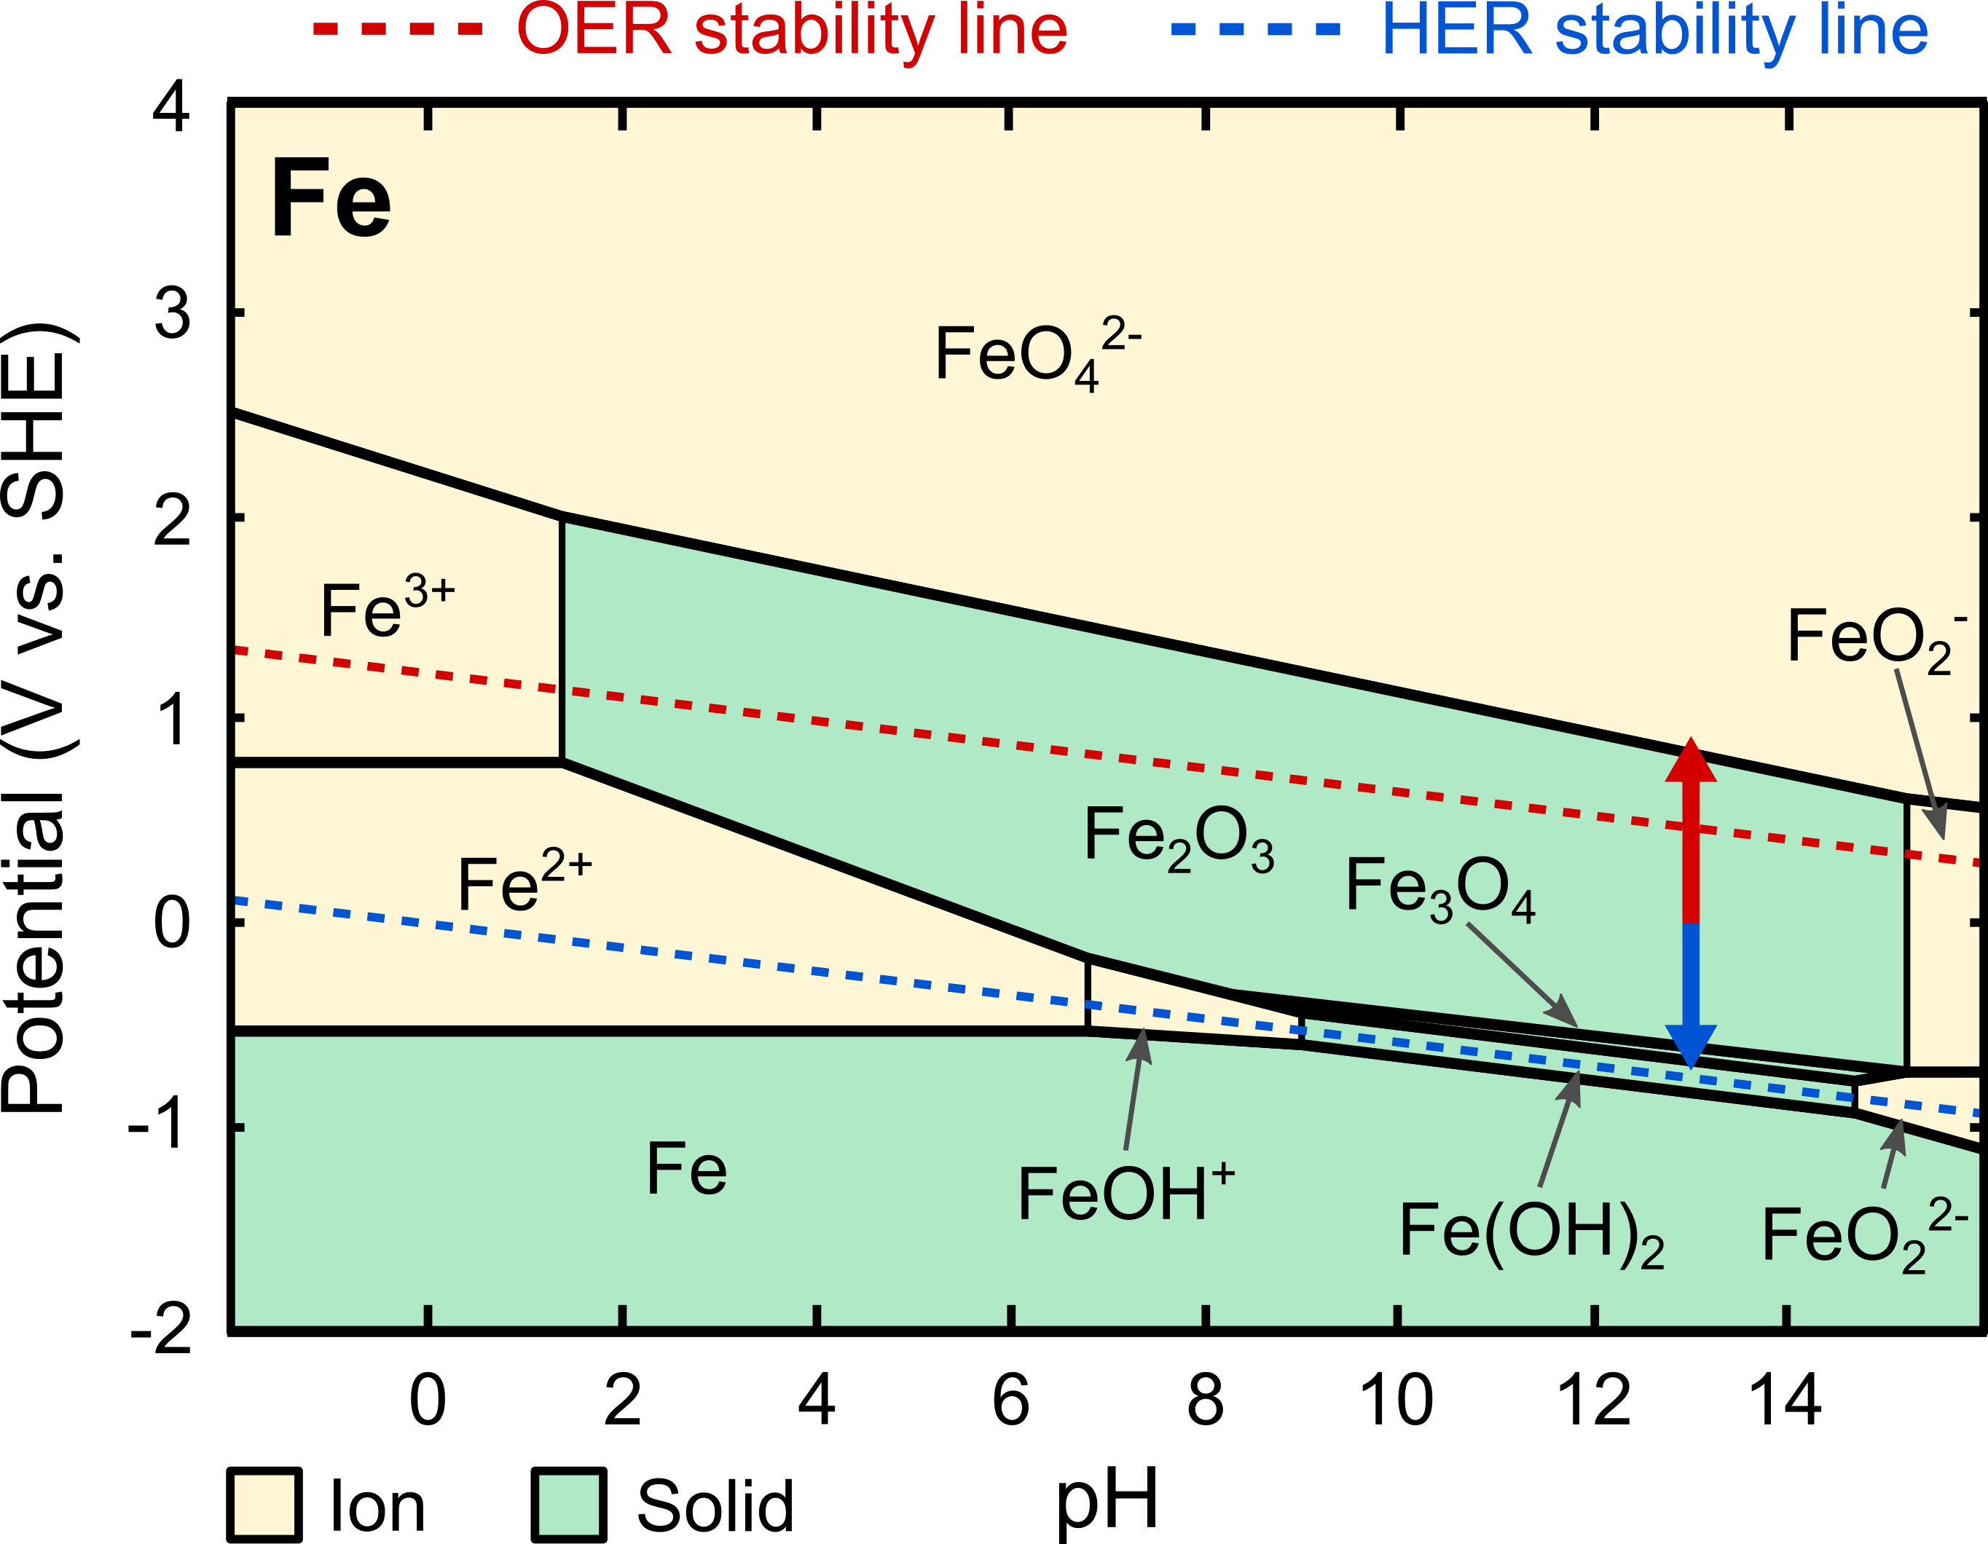
a
b
c

Slide 3
a
b
c

Slide 4
a
b
c

